Slide 1
Teaching Braille Reading AND Writing Using Actual Tactuals Materials BrailleBlazer and Unified English Braille (UEB) Practice Sentences
A Comprehensive, Step-by-step method

Slide 2
For GITWL NOV/DEC 2023 R-take this out Presented by
Roberta Becker - Certified Braille transcriber
retired tvi
TAMARA BLACK - tvi – Certified Curriculum Specialist

Slide 3
Actual tactuals braille
www.Actualtactuals.com
actualtactuals@gmail.com
1-516-434-1506

Slide 4
PHOTo-front cover of book A comprehensive, step-by-step method for teaching braille reading and writing

Slide 5
BrailleBlazer
Beginning Braille Reading
Activity Book
Volume 1
Braille

Slide 6
This is a temporary slide:
Tamara’s student M has won:
Kindergarten:
First Grade:
Second Grade:
She is now in Second Grade and
Tamara’s student L can now read

Slide 7
Types of Activities included in this book:
Tracking
Reading Activities
Review (of words that will be in these sentences)
New Word(s)
Reading Sentences
Sentence Jumbles
Paragraphs
Word Families (ex.: all-if you know the word “all” you can read ball, call, fall, hall, mall, etc.) (at, ad, et, ice, oy, +)
Review Sentences or Quiz
Reading Comprehension

Slide 8
Before we go on-I’d like to share an excerpt from an unsolicited comment that I received last week. (November 2023)
It’s from a college professor, who is also the Vision Studies TVI Program Coordinator at UMass in Boston. She is also a TVI. She wrote about a dual media learner that she teaches.

Slide 9
“I decided to try Braille Blazer with him to reinforce some skills.
Well, the structure, routine and sequence of Braille Blazer with the repetition of words and sentences, word families, tracking, sentence jumbles and paragraphs have made a huge difference in making him a confident braille reader.
He asks to do pages from the book every day as part of our lesson.
He's become a different braille reader in a positive way.
So, thank you and I look forward to volume 2 coming out.”

Slide 10
BrailleBlazer: Beginning Braille Reading Activity Book (All of Lesson 2)
Part 2 Activity 1 Tracking: you
you -------------- you ---------- you -----
you ------ you ---------------- you -------
---------------------------- = ---------------
you --- you ------ can -------- you ------
you -------- do ------- you ------- you --
you ----- you ---------- you ---- help ---
Part 2 Activity 2 Reading
Review: help can (2)
New Word: you
1. help
2. help help
3. can you help
4. can you help
5. you can help

Slide 11
Part 2 Activity 3 Reading
Review: can you do it he help (6)
can you do it
can he help you
he can help you
he can help you
he can help you do it
Part 2 Activity 4 Reading
Review: I can help you we do it (7)
I can help you
we can help you
I can help you do it
we can help you do it
we can help you do it

Slide 12
Part 2 Activity 5 Paragraph
help help help -- can you help -- I can
help –
Part 2 Activity 6 Sentence Jumbles: you
I can help you
I can help you book
2. he can help you
he can help book you
3. you can help me
you book can help me
Part 2 Activity 7 Tracking: me
(similar to Part 2 Activity 1)

Slide 13
Part 2 Activity 8 Reading
Review: help can you I (4)
New Word: me
help me
can you help me
I can help
can you help me
you can help me
Part 2 Activity 9 Tracking: want
(similar to Part 2 Activity 1)
Part 2 Activity 10 Reading
Review: I help can you do (5)
New Word: want
I want help
I can help you
do you want help
I do want help
I do want help

Slide 14
Part 2 Activity 11 Paragraph
help -- help me -- can you help me -- I can
help –
Part 2 Activity 12 Tracking: to
(similar to Part 2 Activity 1)
Part 2 Activity 13 Reading
Review: I want help you me do (6)
New Word: to
(5 sentences)
Part 2 Activity 14 Reading
Review: can we help you do it want to me (9)
(5 sentences)
Part 2 Activity 15 Paragraph
I want to help -- do you want me to
help -- do you want me to help you --

Slide 15
Part 2 Activity 16 Tracking: if
(similar to Part 2 Activity 1)
Part 2 Activity 17 Reading
Review: help me you can want to do it (8)
New Word: if
(5 sentences)
Part 2 Activity 18 Reading
Review: I can help you if want he we to me (10)
(5 sentences)
Part 2 Activity 19 Paragraph
he can help you -- he can help you if you want --

Slide 16
Note 1: There is a Contraction and Word Progress Chart at the end of the book.
Note 2: Former print readers may feel that the words in this book are not consistent with their former level of phonetic skills and their comprehension. This may cause them to become discouraged. For this reason, it is important to let your former print readers know that this is
not a book for teaching beginning reading, but
It is a book for teaching beginning BRAILLE reading.
These readers need to know that braille reading requires, first, developing tactile skills, before they can read at their previous level.
Prevail with Braille
www.ActualTactuals.com

Slide 17
PHOTo-front cover of book A comprehensive, step-by-step method for teaching braille reading and writing

Slide 18
Photo-Basic format of book Picture shows an open book, with a spiral binding. The simulated braille sentences are on the left page, and the corresponding print sentences are on the right page. For Teachers (in Print and Braille), Para-professionals, Parents, Transcribers.

Slide 19
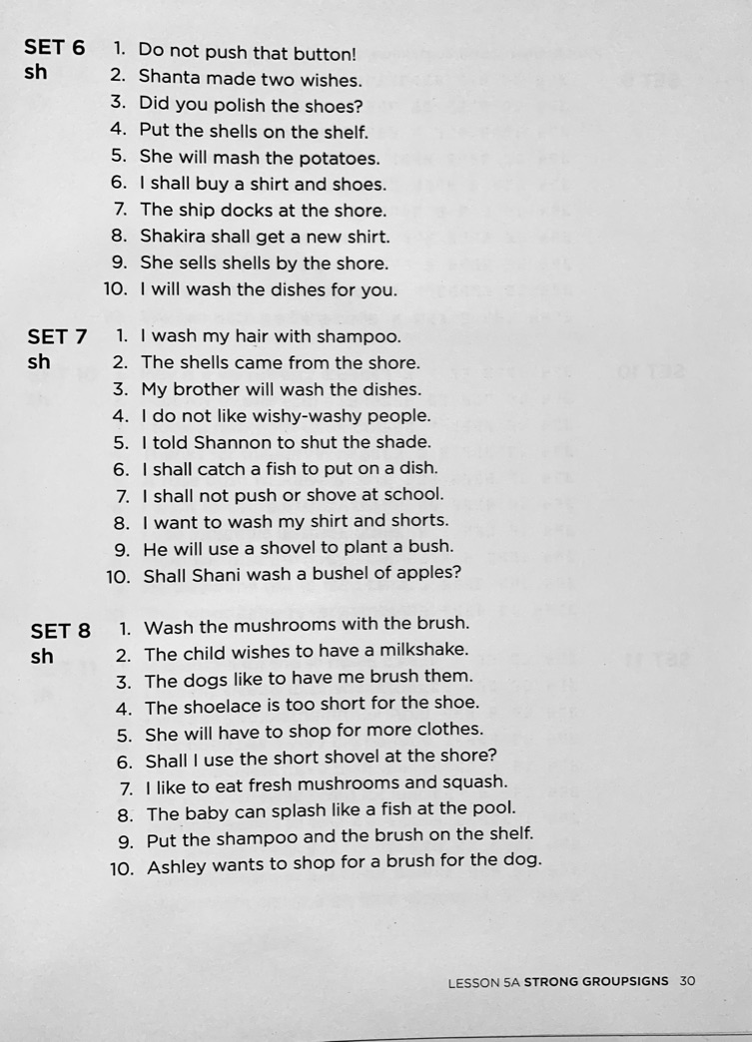
Photo-page from print book teacher CAN easily pick the correct level, in that lesson, for each student.

Slide 20
Photo-Example of SimulateD Braille

Slide 21
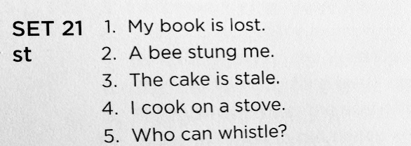
photo-Example of print sentences

Slide 22
photo of 3 book set- print book and 2 double-spaced braille books

Slide 23
Description of format
Lesson 1 Alphabet Practice. No contractions
The actual reading lessons begin in lesson 2.
Lessons 2-10 introduce the contractions, systematically
Lessons 11-14 introduce common symbols that are used in writing (punctuation), math, typeform indicators (bold, italic, underline), and electronic addresses for emails and social media.

Slide 24
Picture of first page of lesson 2 in print book
Beginning of each lesson shows:
--All of the contractions that are covered in the lesson.
--All covered contractions
--Simplified rule for this contraction
--New punctuation that is covered in the lesson
--Hints for remembering many of the new configurations

Slide 25
Easy to use and geared towards success-Repetition
Lesson 2 Alphabetic Wordsigns
Set 1- can do it
I can do it.
He can do it.
We can do it.
Can he do it?
Can my dad do it?

Slide 26
Lesson 2-Set 2 from here, only one contraction introduced at a time, throughout the book
Set 2 – you
You can do it.
Can you do it?
I can do it, can you?
Do you want to do it?
You can do it. I can do it, too.

Slide 27
easy to use – all of the lessons are planned and prepared for you
You don’t need to reinvent the wheel everyday.
No trying to write sentences with contractions. No embossing.
Flexible and adaptable.
***YOUR STUDENTS WILL BE SUCCESSFUL***
This is true for children and adults.
Many teachers have said that they LOVE this book, and they use it everyday!

Slide 28
What makes it easy to use? Slide 1
Lessons are all ready to use, in print and braille – all planning is done for you.
2. Easy to follow directions
3. Contains simple vocabulary ….
4. Double-spaced braille book it is easier for the students to track
From line to line
No confusion with dots in line above or below

Slide 29
What makes it easy to use? Slide 2
5. Every contraction is introduced individually.
6. No contraction is used in the sentences until it has been presented as a lesson.
7. The same new contraction is used numerous times in one sentence.
8. All previously taught contractions are used repeatedly throughout the book, to give continued practice.
9. Lots of repetition of contractions-builds confidence!
10. Stairstep format makes it easy for teacher to decide where to begin.

Slide 30
The same new Contraction is used numerous times in one sentence. A lot of repetition of contractions, so that students can feel secure in both reading and writing. Easy words. New words and concepts. Sentences promote discussion.
Cho chews gum.
Chad has a watch.
I will scratch an itch.
4. Baby chicks act cute.
5. Can he catch this ball?
6. I will check on the baby.
7. This candy is very chewy.
8. Can a chimp catch a ball?
A. In print, stairsteps from easier to more challenging.
B. Mostly multiple use of contractions in 1 sentence.
C. Use for braille reading and writing assessment.
D. Use assessment to produce IEP goals.

Slide 31
Why it is easy to use? Slide 3
11. Contains hints or mnemonic devices to help remember some letters, contractions, or punctuation that are commonly confused.
These include: and, st, with, ., ?, !, among others.
12. Braille contractions that are used in different ways are introduced in separate sections (next slide).
13. Rules are included at the beginning of every Lesson.

Slide 32
Contractions that are used in different ways are introduced in separate sections
From Lesson 8A (Strong Wordsigns)
Red = New Contractions Green = Previous Black = uncontracted
What day is this?
The day was ending.
From Lesson 8B (Strong Groupsigns)
Friday is payday for me.
My birthday is next Saturday.
Did you underst/and the questions?
I cannot underst/and wh/en and where those young people do their work.

Slide 33
challenges
Teachers love the Challenges that have students read sentences that have 2 “confusing” contractions in them.
For example: (en/in) (ar/ea) (of/ff) or just 2 lower cell contractions in them.
When will you come inside?
The year has four seasons.
The official state flower is a daffodil.
Debbie has the sniffles.

Slide 34
Photo-page from print book Use for braille reading and writing assessments, and IEPs

Slide 35
Photo-page from print book ways that you can use this book in lessons*

Slide 36
Appendix a, b, and c
There is an Appendix section with 3 charts to help you find the contractions/configurations (character) that you need.
Numbers, Letters, and Contractions organized by type of contraction)
B. Symbols that are covered in this book, organized by Lesson number 11-14
C. Alphabetical list of symbols that are covered in Lesson 11-14

Slide 37
Picture of first page of Appendix A- numbers, letters, and contractions

Slide 38
Picture of Appendix B- contractions as they appear in lessons

Slide 39
Picture of first page of Appendix c- lessons 11-14 alphabetical order

Slide 40
CONTRACTION PROGRESS CHART Allows you to keep track of the reading and writing contractions that the student has mastered. The chart is available in both print and braille teachers edition.

Slide 41
Contraction progress chart Aligns with the Lesson in the book

Slide 42
ECC – Expanded core curriculum
ECC
Teaching the braille code
Reading braille
Writing braille
Additionally:
QWERTY keyboarding- when they have mastered reading and writing
Sentences can be read in braille
Student can type them on the QWERTY keyboard
Practice in spelling out contracted words
Using a screen reader to check sentences
QWERTY keyboard commands
Also, refreshable braille display computer commands

Slide 43
My favorite facebook groups
Write it out exactly as it is written here:
teachers of the blind and visually impaired/O&M specialists
parents of blind and visually impaired children

Slide 44
Thank you for joining us!!!
Roberta Becker and Tamara Black
Actual tactuals braille
www.Actualtactuals.com
actualtactuals@gmail.com
1-516-434-1506

